Slide 1


SWARM ROBOTS
BY AL SAIAARI MOHAMMED NASSER ( 1734429 )

Slide 2
TABLE OF CONTENTS
01
02
03
INTRODUCTION
BACKGROUND
Types
04
05
06
COMPONENTS
APPLICATIONS
conclusion

Slide 3
INTRODUCTION
O1
What are swarm robots?

Slide 4
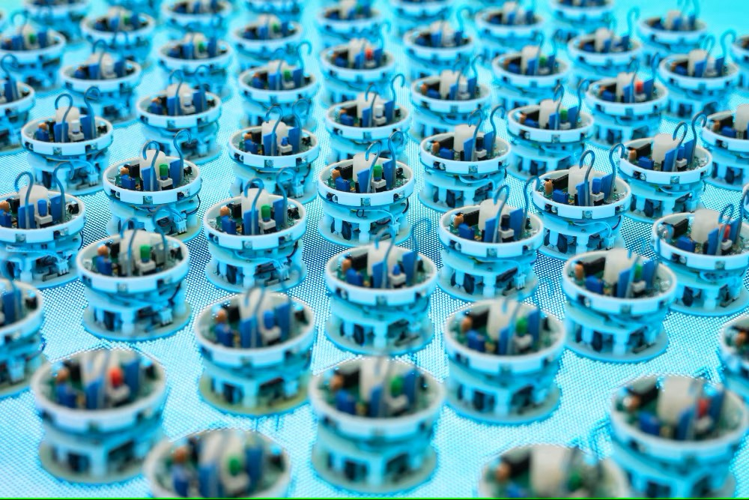
SWARM ROBOTS
Swarming robots are a form of robotic system that comprises of several little robots cooperating to accomplish a single objective. These robots are able to coordinate their activities and interact with one another to carry out complicated tasks more quickly and effectively than a single robot could.
Swarming robots are modelled after social insects like ants and bees, which cooperate in huge numbers to carry out activities like foraging and nest-building. Swarming robots have the potential to revolutionise a wide range of industries, including manufacturing, agriculture, and search and rescue.

Slide 5
BACKGROUND
O2

Slide 6
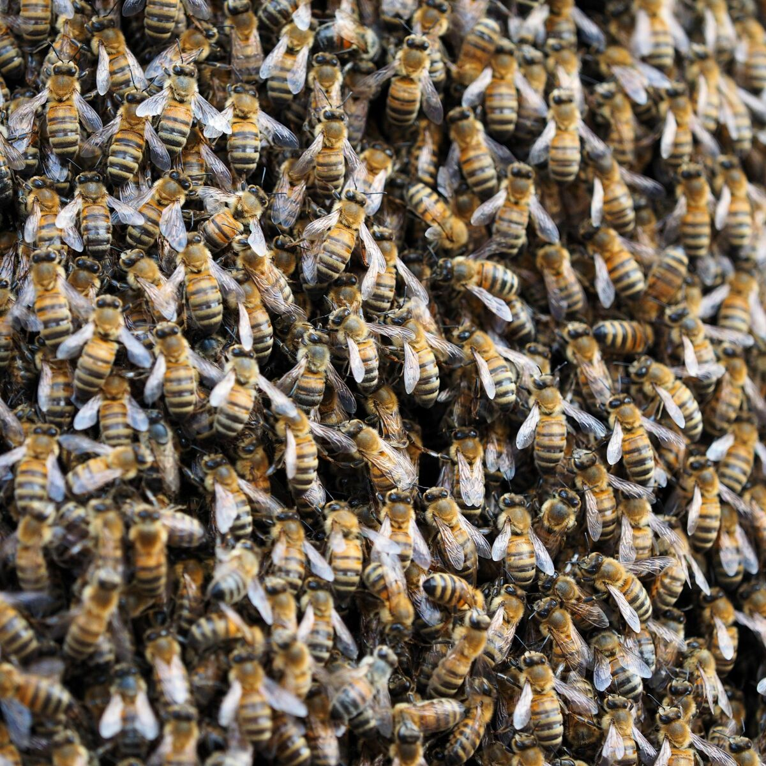
BACKGROUND
The notion of swarming robots has been around for a long time; the first version was a class of robots called "Cogbots" that were designed to behave like insects. Each robot engaged in a different task while collaborating with its neighbors to achieve a common goal.
The technology didn't start to catch up with the idea, though, until the early 2000s. University of Southern California researchers created a swarm of tiny robots in 2002 that could cooperate to move things that were considerably larger than themselves.
Swarming robots have since been employed in other fields, including as surveillance, monitoring of the environment, and even art projects. The applications for swarming robots are nearly limitless as technology advances.

Slide 7
Types
O3

Slide 8
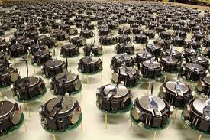
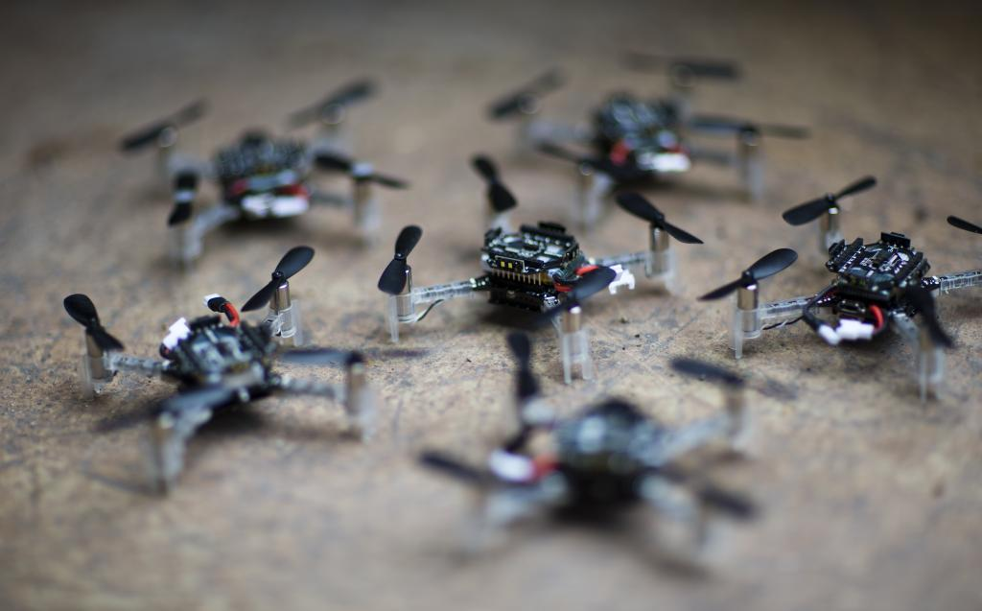
Swarming robots come in a variety of varieties, each with special skills and design elements. The kilobot, a little, inexpensive robot made for study, is one popular variety. Kilobots can collaborate to carry out straightforward activities like moving things and creating patterns. They can speak with one another wirelessly.
The quadcopter, a little flying drone that can be programmed to fly in formation with other drones, is another sort of swarming robot. Quadcopters may be used to deliver tiny goods over short distances and are frequently utilized for aerial surveillance and mapping.

Slide 9
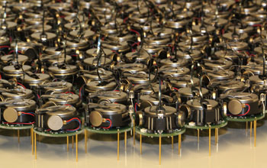
KILOBOTS
The term "Kilobot" refers to both their little size and the objective of building a system with several robots. These extremely little robots have motors that vibrate and have a diameter of only 3.8 centimetres.
In order to communicate with one another and plan their operations, they also have infrared transmitters and receivers.The Kilobot project's main goal was to build a scalable system that could handle hundreds or even thousands of robots at once. Researchers wanted to make swarm robotics more accessible and permit large-scale experimentation, so they kept the robots basic and affordable.Kilobots have a decentralised method of coordination, therefore there isn't a single leader or controller robot.
Instead, they rely on interpersonal interactions and infrared transmission to exchange information locally. Each Kilobot has a set of fundamental instructions that it must follow in order to cooperate with other robots and carry out sophisticated behaviours.

Slide 10
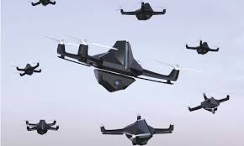
QUADCOPTERS
Unmanned aerial vehicles (UAVs) that cooperate to carry out tasks are referred to as quadcopter swarm robots, also known as quadrotor swarms or drone swarms. Due to their adaptability, agility, and potential for a wide range of applications, these swarms of quadcopters have attracted a lot of interest in recent years.
Each individual autonomous quadcopter in the swarm is capable of vertical takeoff, hovering, and quick manoeuvres in the air. Quadcopters generally have four rotors that are placed in a cross-like pattern. This arrangement enables them to produce lift and regulate their movement by varying the rotor speeds.
Future research and application possibilities for quadcopter swarm robots are enormous. Current research focuses on improving the autonomy, robustness, scalability, and coordination of swarms.
Quadcopter swarms are anticipated to become more important in a variety of fields, from airborne transportation and logistics to disaster response and surveillance, as communication, sensing, and control technologies progress.

Slide 11
COMPONENTS
O4

Slide 12
MAIN COMPONENTS OF SWARMING ROBOT
Frame & Design
Propulsion System
Navigation & Control System
Data Collection
Data Transmission
Power Management

Slide 13
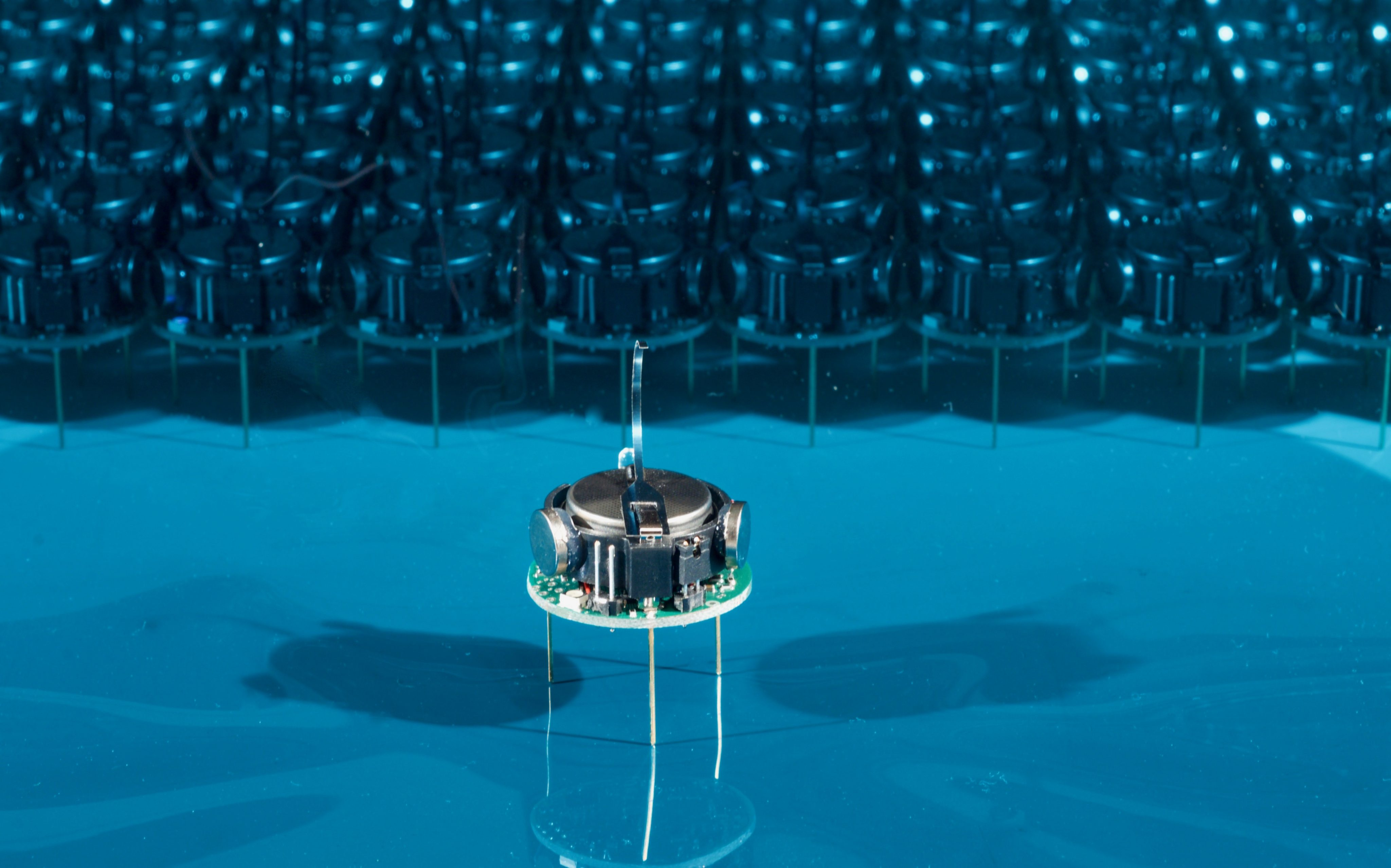
1. Frame & Design
Swarm robots come in a variety of sizes and forms, and the frame and design are determined by the intended use and operating environment.
Swarm robots may be built in a modular or unitary manner.
Unitary robots, on the other hand, comprise of a single unit that completes all necessary activities.
Modular robots, on the other hand, consist of numerous interchangeable modules that may be coupled in different configurations to accomplish varied functionality.

Slide 14
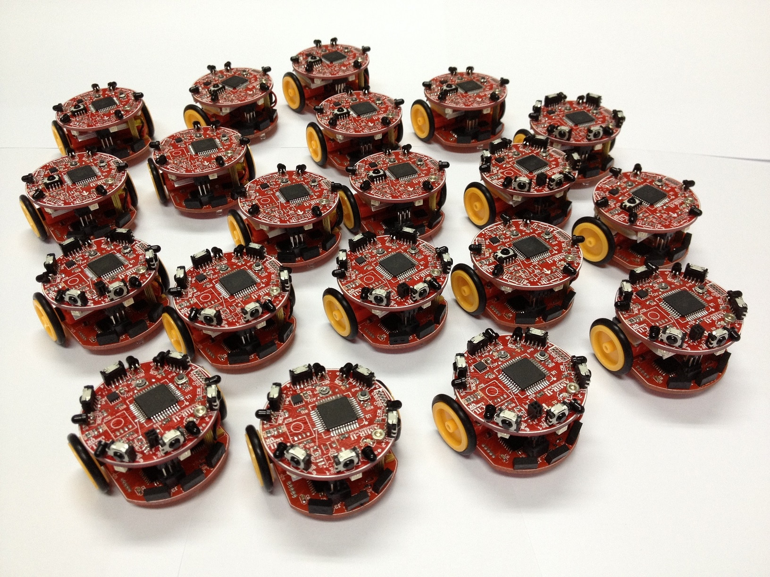
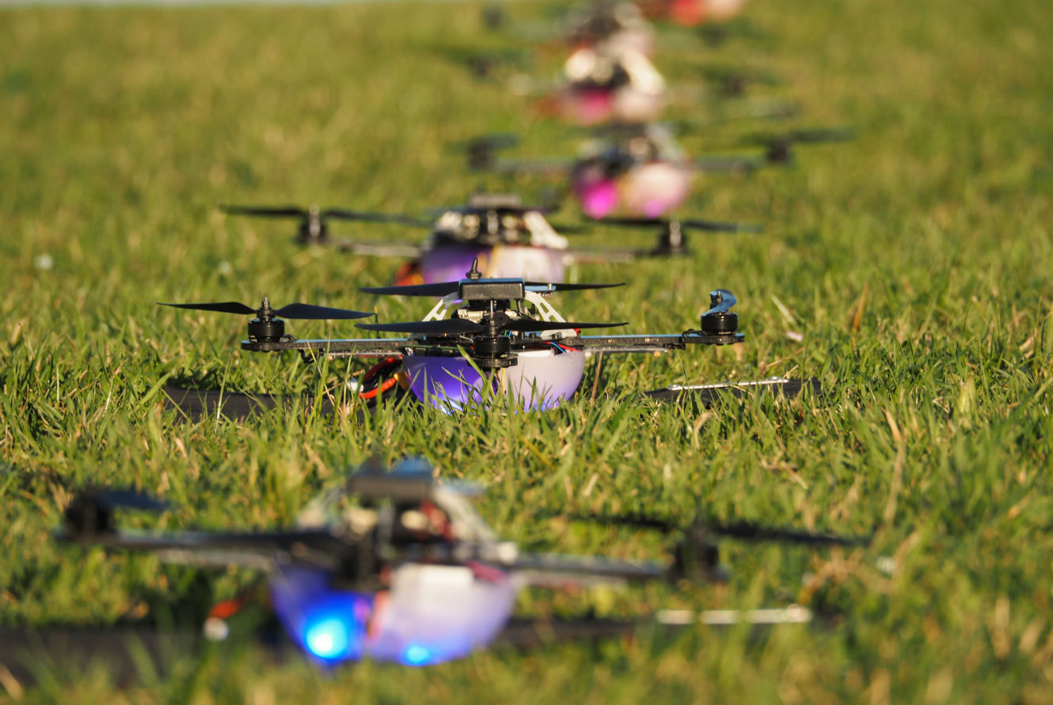
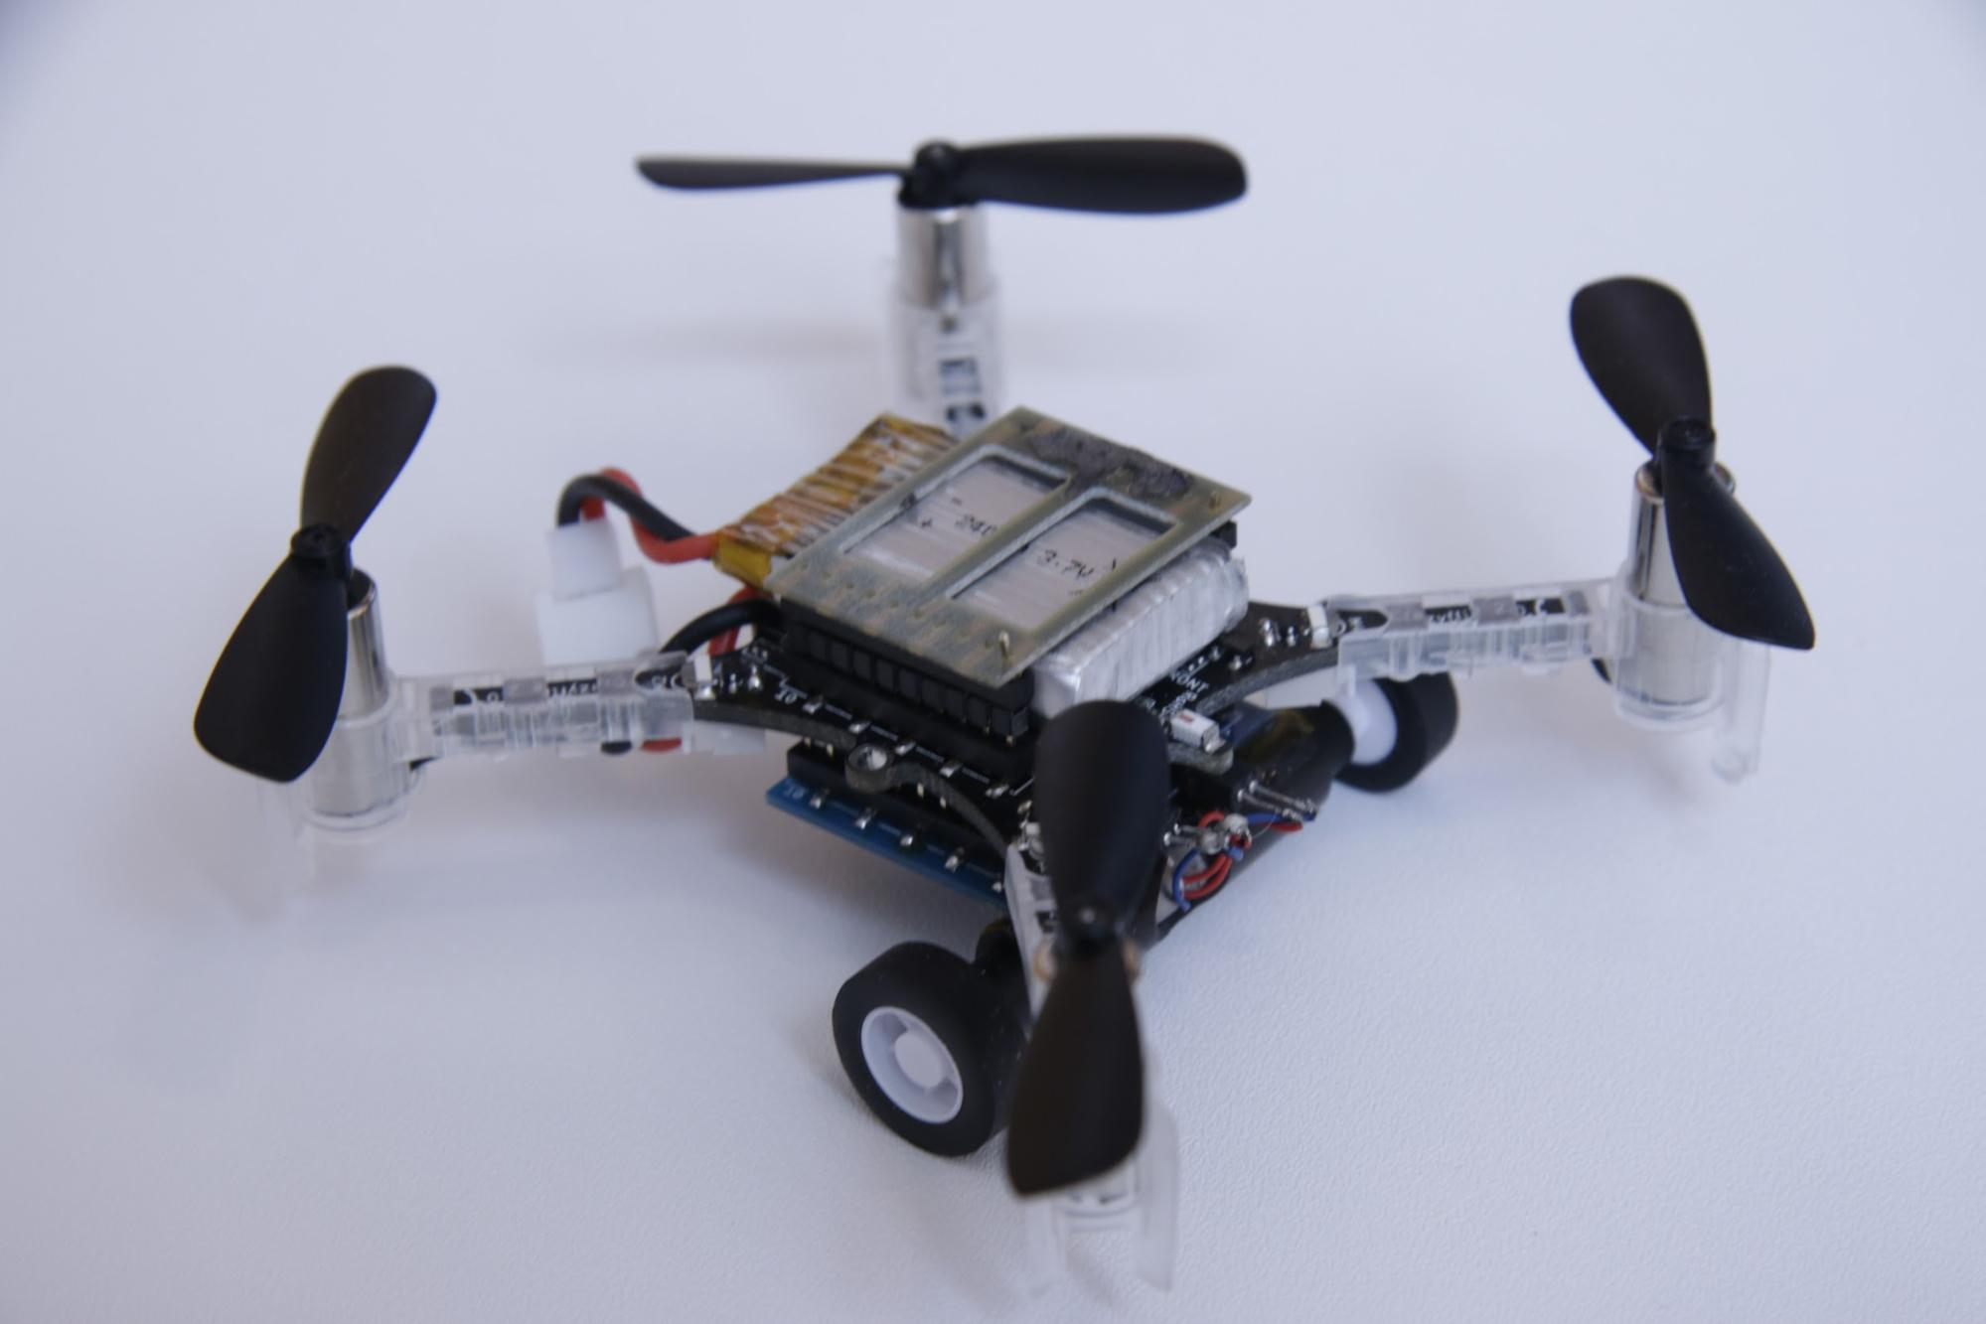
1. Frame & Design
Wheeled Robots
Use wheels for locomotion and are suitable for operating on flat surfaces.
Generally fast and agile, but their mobility is limited by the terrain they operate on.
Flying Robots
Use rotors or wings for flight and are suitable for operating in aerial environments.
Generally fast and agile, but flight time is limited by battery capacity.
Hybrid Robots
Combine multiple types of locomotion to achieve greater versatility and adaptability.
For instance, a wheeled robot can transform into a legged robot to overcome obstacles or a flying robot to survey a large area.

Slide 15
2. Propulsion System
Flying Robots
Flying swarm robots use propellers or rotors to generate lift and thrust
for flight.
Efficient and fast and can operate in aerial environments such as skied or indoor spaces.
Hybrid Robots
Some swarm robots use a
combination of propulsion systems to achieve greater versatility and adaptability.
Wheeled Robots
Most common types of propulsion
systems used by swarm robots.
Wheels are driven by motors and
provide movement on flat surfaces.
Fast and efficient and its speed can be controlled easily.

Slide 16
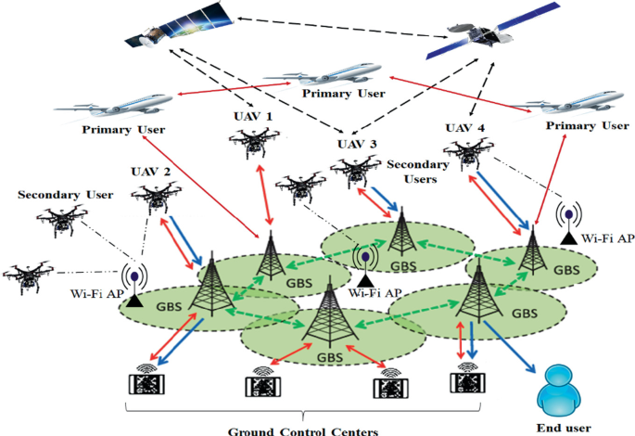
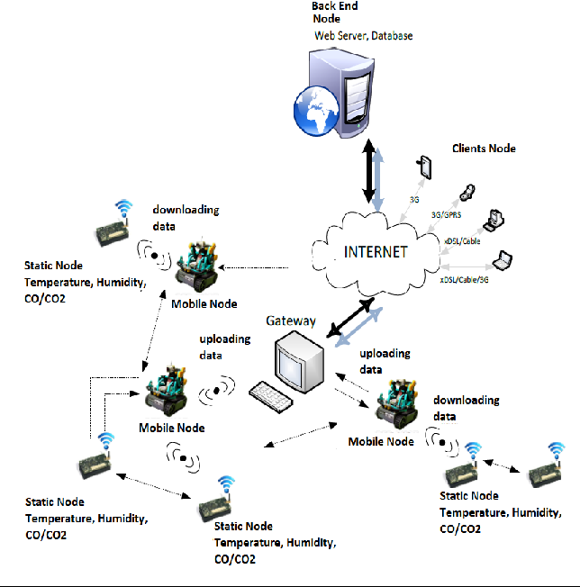
3. Navigation & Control System
GPS: Swarm robots can utilise GPS and other navigational sensors like magnetometers, accelerometers, and gyroscopes to figure out where they are and how fast they're moving. This data may be utilised to cooperate with other robots and prevent collisions and obstructions while planning and carrying out moves.
Wireless Communication: Wireless communication between swarm robots and a central control system allows them to exchange information and plan their movements. They may now exchange information, update their locations, and carry out activities in a dispersed and well-coordinated manner thanks to this.
Sensor Fusion: Some swarm robots use sensor fusion techniques to combine data from multiple sensors and sources, such as cameras, lidar, and radar. This enables them to build a more accurate and complete picture of their environment, which in turn improves their navigation and control.

Slide 17
4. Data Collection
SENSORS
Cameras
LiDaR
Inertial Measurement Units (IMUs)
Proximity Sensors
Microphones
ACTUATORS
Legs
Tentacles
Pneumatic/ Hydraulic systems
Gripper
Electrostatic Adhesion
Electroactive Polymers

Slide 18
5. DATA TRANSMISSION
WiFI: Common form of wireless communication used by swarm robots to transmit data. Provide high-speed communication and can support multiple robots simultaneously.
Bluetooth: Can be used to provide communication between nearby robots and can also be used to communicate with other devices such as smartphones or laptops.
Zigbee: Zigbee is a wireless communication protocol designed for low-power and low-data rate applications. Allow communication between a large number of robots while consuming minimal power.

Slide 19
6. POWER MANAGEMENT
Batteries: Can be small and lightweight, and can provide high energy density. Have limited capacity and need to recharged or replaced periodically
Fuel Cells: Can power the robot longer than batteries. Convert energy from fuel such as hydrogen or methanol into electrical energy. Require source of fuel which can add weight to the robot.
Solar Panel: Lightweight and require no fuel, but may not be able to provide sufficient power in low light conditions when robot is in shade.

Slide 20
APPLICATIONS
O5

Slide 21
APPLICATIONS
Search and Rescue: Swarm robots can be deployed in disaster scenarios to search for survivors in hard-to-reach or hazardous areas. They can cover large areas efficiently, communicate with each other to share information, and collaboratively locate and assist trapped individuals.
Environmental Monitoring: Swarm robots are used for monitoring and data collection in environmental studies. They can disperse across a region, gather data on parameters like temperature, humidity, air quality, or water quality, and transmit the information back to a central system for analysis.
Construction and Infrastructure Maintenance: Swarm robots can work together to perform construction tasks, such as assembling structures or repairing infrastructure. By coordinating their actions, they can efficiently complete complex tasks while adapting to changing conditions.
Precision Agriculture: In agriculture, swarm robots can assist in tasks like crop monitoring, pollination, or pesticide application. By working collectively, they can cover large fields, gather data on crop health, optimize resource utilization, and improve overall farm productivity.
Surveillance and Security: Swarm robots can be employed for surveillance purposes, enhancing security in various environments. They can monitor areas, detect intrusions, track objects, and communicate information to a central system or human operators.

Slide 22
conclusion
O6

Slide 23
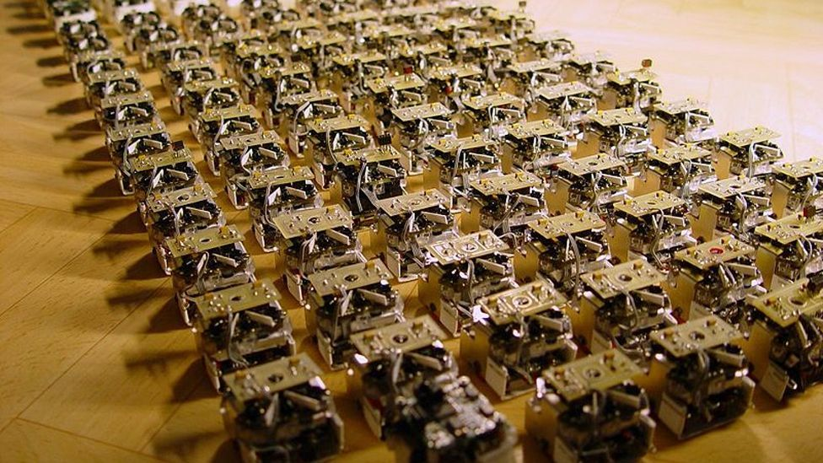
conclusion
Swarm robotics is a cutting-edge technology that might revolutionise a variety of fields and applications, to sum up. Swarm robots have the ability to collaborate in a coordinated and decentralised way, resulting in higher levels of efficiency, adaptability, and resilience. Swarm robots may start to play a bigger role in enterprises and organisations in Malaysia and other parts of the world. Swarm robots has a wide range of possible applications, and its future is both exciting and bright.
1

